Slide 1
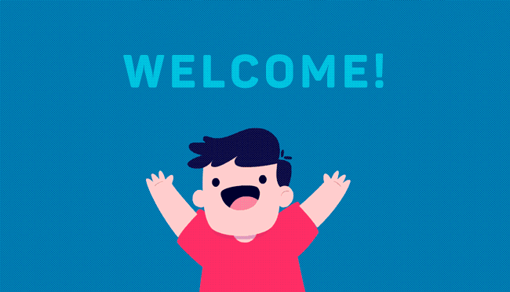

Slide 2
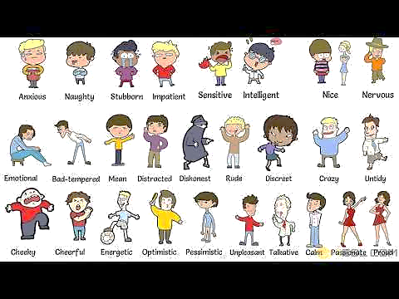
How many adjectives can you remember?

Slide 3
“ What personal qualities do you need to survive in the wild? Why?”

Slide 4
UNIT 6
SURVIVAL
LESSON 2: READING
Jungle challenge

Slide 6
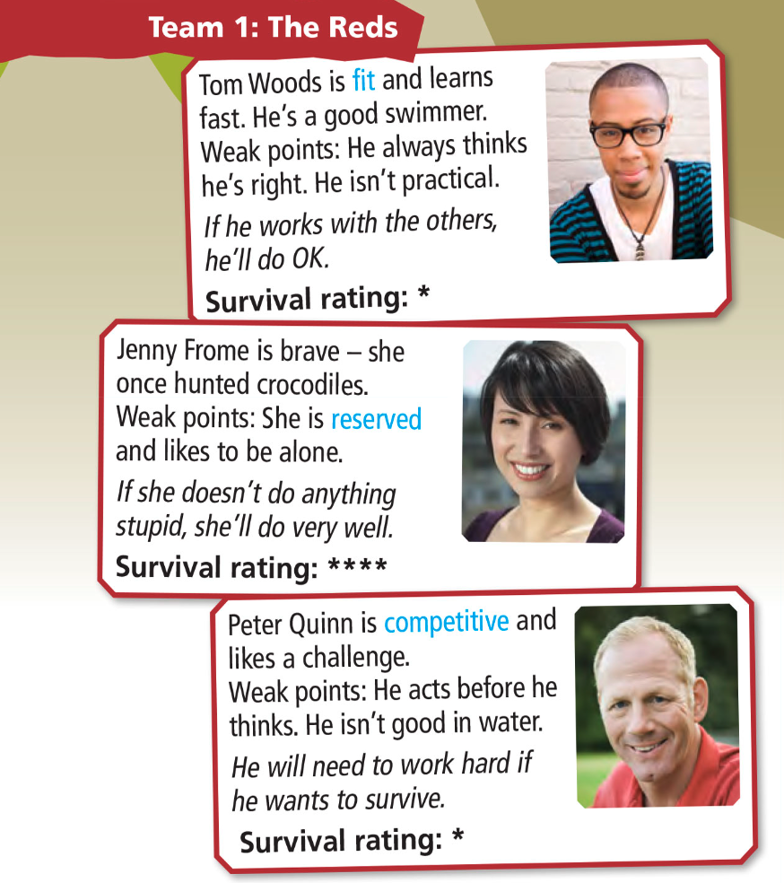
✔ Activity 1: 1 What type of text is it? What type of information do you think will be in the text?
a. a personal blog
b. an advertisement for a TV program
c. a newspaper article

Slide 7
✔ Activity 2: Read and listen to the text and complete the sentences with the name of a team member
Jenny
1 …………………… has the best survival rating.
2 …………………… and …………………… are the weakest contestants.
3 …………………… needs to face his fear of snakes.
4 …………………… probably won’t hunt animals for food.
5 …………………… needs to listen to other people.
6 …………………… will decide which team wins.
Tom
Peter
Ted
Sophie
Tina
Steve Grant

Slide 9
I. NEW WORDS:
1. fit (adj)
khoẻ mạnh
2. practical (adj)
thực tế
3. reserved (adj)
dè dặt, kín tiếng
4. competitive (adj)
có tính cạnh tranh
5. bossy (adj)
hống hách
6. clever (adj)
thông minh

Slide 11
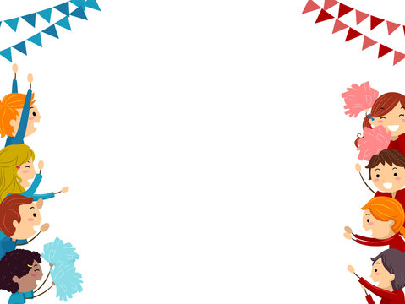
USE IT!Work in pairs. Which team do you think will win the challenge?

Slide 12
- Learn by heart all the new words. - Workbook: Exercises p. - Prepare Lesson 3 – Language Focus.

Slide 13
